Slide 1
Zero-knowledge Proof and Its Applications in Privacy-preserving Cryptocurrencies
Yupeng Zhang
Computer Science and Engineering
Texas A&M University

Slide 2
What is a proof?
teachoo.com

Slide 3
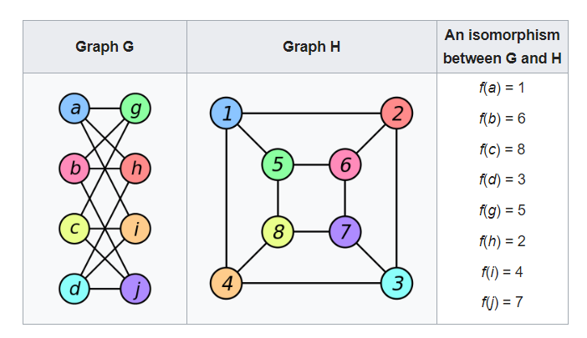
Proof in CS: graph isomorphism
NP (non-deterministic polynomial-time) problem
Hard to find the permutation $Π$
Easy to verify
https://en.wikipedia.org/wiki/Graph_isomorphism

Slide 4
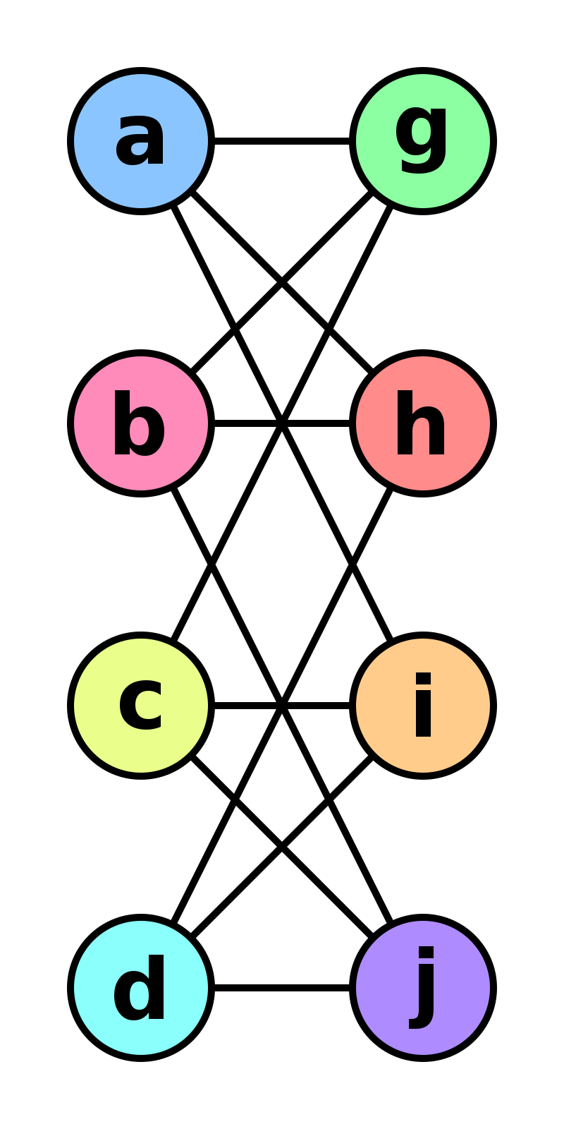
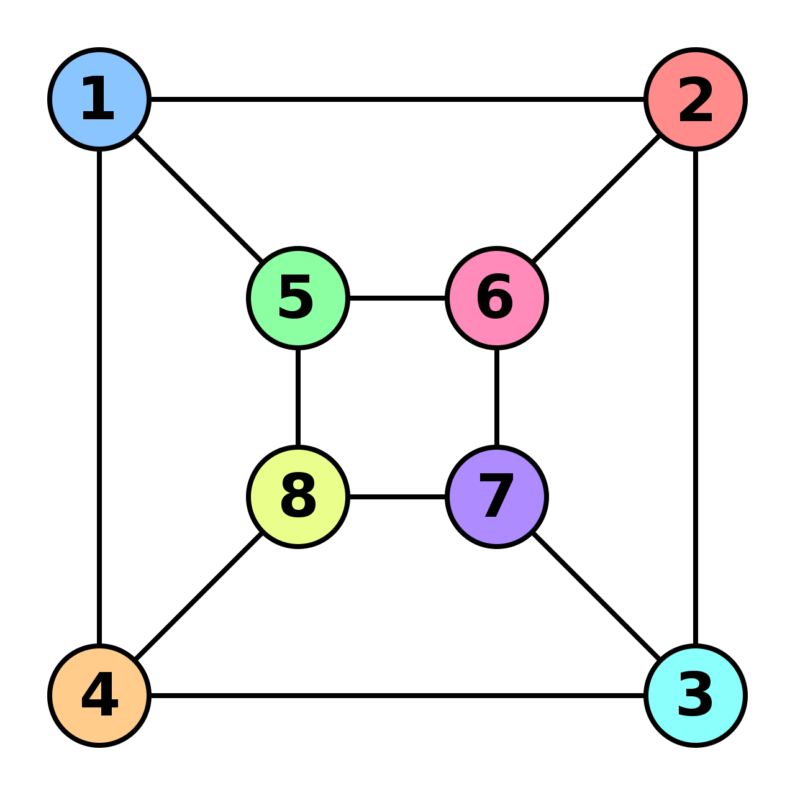
Proof for graph isomorphism
G
H
verifier
prover
isomorphic?
yes!
proof is $Π$
Verify: ✓ or ✗

Slide 5
Graph non-isomorphism
G
H
verifier
prover
isomorphic?
no!
proof?
I don’t have a permutation. ✗
Try all permutations. ✗

Slide 6
Power of randomness
verifier
isomorphic?
prover
no!
Graph I, what is b?
Pick a random bit b = 0 or 1
If b=0, pick a random permutation $Π$, generate graph I = $Π$(G);
If b=1, pick a random permutation $Π$, generate graph I =$Π$(H);
Send graph I to prover, ask what is bit b
G
H

Slide 7
Interactive proof (IP)
verifier
isomorphic?
prover
no!
Graph I, what is b?
Pick a random bit b = 0 or 1
If b=0, pick a random permutation $Π$, generate graph I = $Π$(G);
If b=1, pick a random permutation $Π$, generate graph I =$Π$(H);
Send graph I to prover, ask what is bit b
Correctness: Pr[honest prover, verify ✓] = 1
Soundness: Pr[cheating prover, verify ✓] = $\frac{1}{2}$
Repetition: repeat 100 times, soundness = $\frac{1}{2100}$

Slide 8
Graph isomorphism again
G
H
verifier
prover
isomorphic?
yes!
proof is $Π$
Verify: ✓ or ✗

Slide 9
Interactive proof for graph isomorphism
verifier
isomorphic
prover
witness $Π$
Graph I
b
$σ$ or $σ′$
Pick a random permutation $σ$
send I = $σ$(G),
Compute $σ′$ such that I = $σ′$(H)
If b=0, send $σ$
If b=1, send $σ′$
Repeat 100 times
Verify:
If b=0, check if I = $σ$(G),
If b=1, check if I = $σ′$(H),
G
H

Slide 10
Correctness and soundness
verifier
isomorphic
prover
witness $Π$
Graph I
b
$σ$ or $σ′$
Pick a random permutation $σ$
send I = $σ$(G),
Compute $σ′$ such that I = $σ′$(H)
If b=0, send $σ$
If b=1, send $σ′$
Repeat 100 times
Verify:
If b=0, check if I = $σ$(G),
If b=1, check if I = $σ′$(H),
G
H
Correctness: 1
Soundness: $\frac{1}{2^{100}}$

Slide 11
Zero-knowledge
verifier
isomorphic
prover
witness $Π$
Graph I
b
$σ$ or $σ′$
Pick a random permutation $σ$
send I = $σ$(G),
Compute $σ′$ such that I = $σ′$(H)
If b=0, send $σ$
If b=1, send $σ′$
Repeat 100 times
G
H

Slide 12
Zero-knowledge proof (ZKP)
Public computation C
secret data
verifier
prover
C(data) = result +
Verification: ✓ or ✗
Correctness: honest prover, verification is ✓
Soundness (integrity): Pr [verification is ✓ and result ≠ C(data)] ≤ $\frac{1}{2100}$
Zero Knowledge (privacy): the proof leaks no information

Slide 13
Efficiency measures
Public computation C
secret data
verifier
prover
C(data) = result +
Verification: ✓ or ✗
proof size
verifier time
prover time

Slide 14
Agenda
What is ZKP?
History of ZKP
Why ZKP? Applications in blockchains and cryptocurrencies
Privacy-preserving cryptocurrency (Zcash)
Scalability (zkRollup) – Prof. Eli Ben-Sasson next lecture
How to build ZKP?
Construction of general-purpose zero-knowledge proofs from interactive proofs

Slide 15
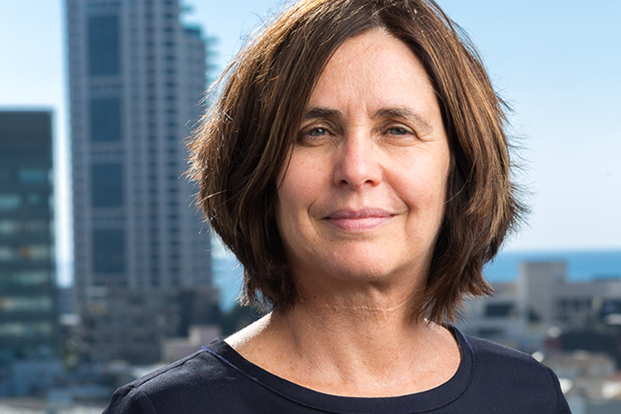
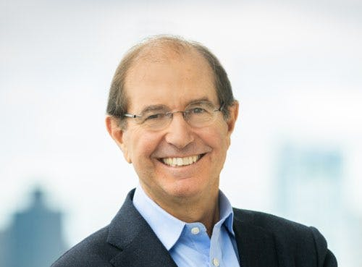
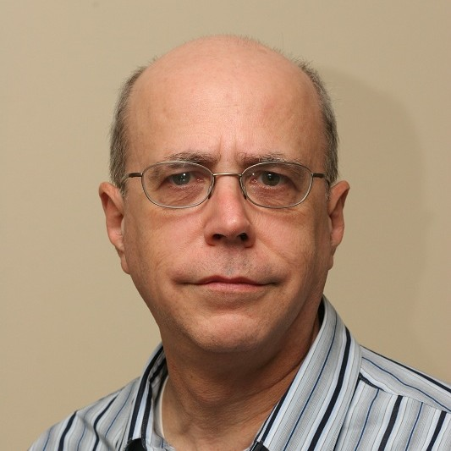
First paper
The Knowledge Complexity of Interactive Proof Systems, 1985
Shafi Goldwasser Silvio Micali Charles Rackoff

Slide 16
Merkle hash tree (Ralph Merkle, 1988)
root hash
commitment
prover
verifier
3rd element
a₃
a₄
H(a₁,a₂)
H(H_{5,6},H_{7,8})
root hash
result
proof
H(H_{1,2,3,4},H_{5,6,7,8})
H(H_{1,2,3,4},H_{5,6,7,8})
H(H_{1,2},H_{3,4})
H(H_{5,6},H_{7,8})
H(H_{1,2},H_{3,4})
H(H_{5,6},H_{7,8})
H(a₁,a₂)
H(a₃,a₄)
H(a₁,a₂)
H(a₃,a₄)
H(a₅,a₆)
H(a₇,a₈)
a₃
a₄
a₁
a₂
a₃
a₄
a₅
a₆
a₇
a₈

Slide 17
Theoretical results
IP=PSPACE Adi Shamir, 1992
Probabilistic checkable proofs (PCP) theorem
Sanjeev Arora, Carsten Lund, Rajeev Motwani, Madhu Sudan, and Mario Szegedy. Proof verification and the hardness of approximation problems, 1998.
Sanjeev Arora and Shmuel Safra. Probabilistic checking of proofs: A new characterization of NP, 1998.
Irit Dinur. The PCP theorem by gap amplification, 2007

Slide 18
Probabilistic checkable proofs
verifier
prover
PCP theorem

Slide 19
Generic ZKP in theory
verifier
Any computation in NP
prover
Joe Kilian. A note on efficient zero-knowledge proofs and arguments (extended abstract), 1992.
Silvio Micali. Computationally sound proofs, 2000.

Slide 20
Recent development of ZKP
Theoretical:
[Bab85, GMR85, BCC86, BGGHKMR90, BFLS91, FGLSS91, ALMSS92, AS92, Kil92, LFKN92, Sha92, Mic94, CD98, BG02, BS05, GOS06, BGHSV06, IKO07, GKR08, IKOS08, KR09, GGP10, Groth10, GLR11, Lip11, BCCT12, BCIOP13, GGPR13, PST13, Tha13, KRR14, BCCGP16, BCS16, Groth16, RRR16, BBC-GGI19, BCG20, BCL20, BHRRS20, RZR20, BHRRS21, . . . ]
Practical:
[SBW11, CMT12, SMBW12, SVPBBW12, TRMP12,BCGTV13, BFRSBW13, BFR13, DFKP13, PGHR13, SBVBPW13, VSBW13, BCGGMTV14, BCTV14a, BCTV14b, FGP14, FL14, KPPSST14, BBFR15, CFHKKNPZ15, CTV15, KZMQCPPsS15, WSRHBW15, LFKP16, FFGKOP16, GMO16, NT16, WHGsW16, AHIV17, CDGORRSZ17, WJBsTWW17, ZGKPP17a, ZGKPP17b, BBBPWM18, KPS18, SAGL18, WTsTW18, WZCPS18, ZGKPP18, BAZB19, BBHR19, BCRSVW19, CFQ19, MBKM19, XZZPS19, ZXZS20, BFHVXZ20, Setty20, CHMMVW20, COS20, ZLWZSXZ21, LXZ21, FDNZ21, GLSTW21, … ]

Slide 21
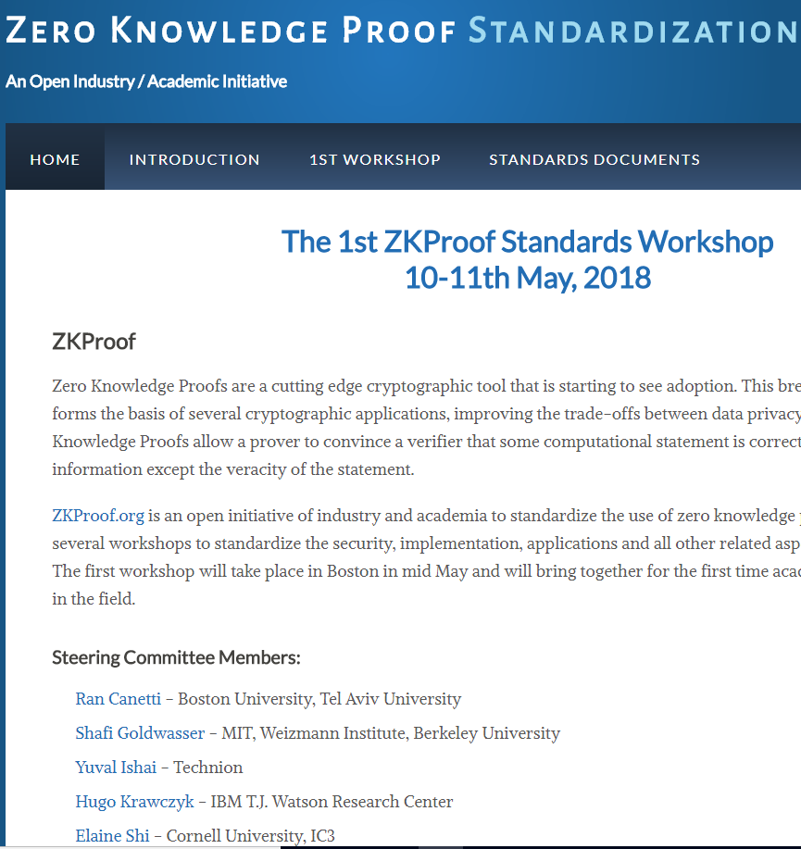
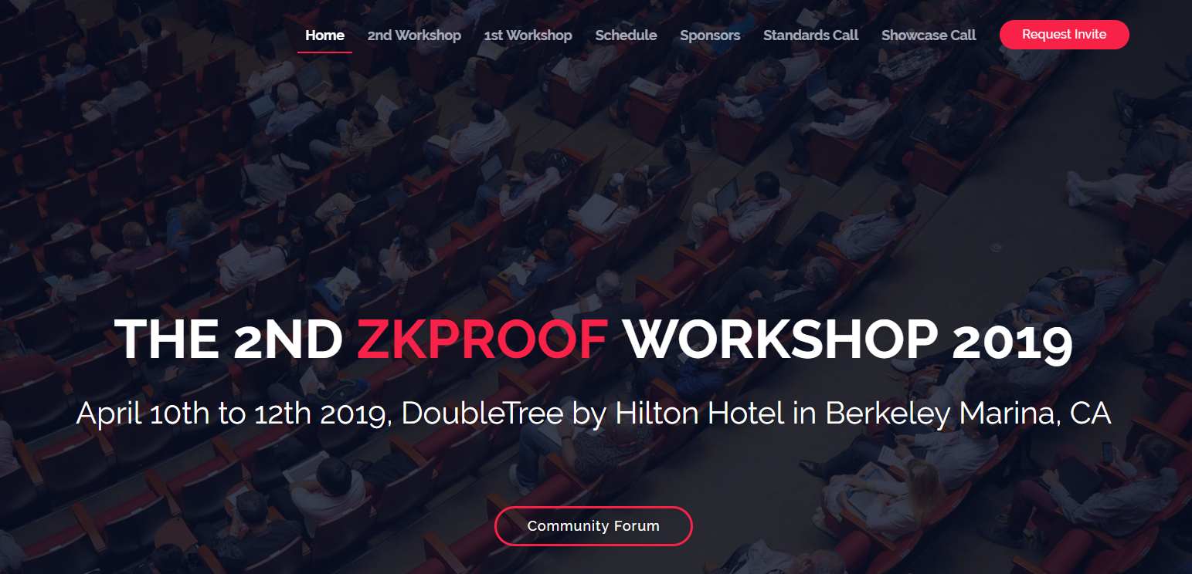
Standardization Workshops

Slide 22
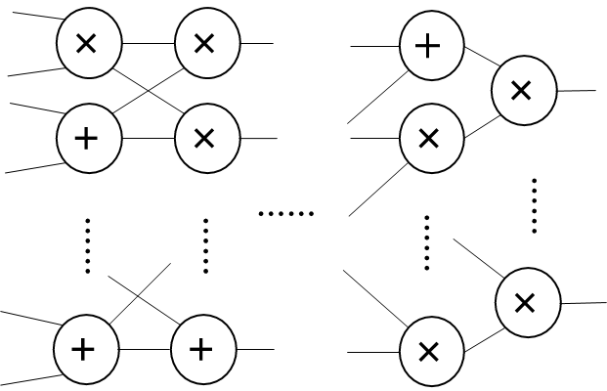
Pinocchio and zkSNARK
verifier
prover
Any circuit
Bryan Parno, Jon Howell, Craig Gentry, and Mariana Raykova. Pinocchio: Nearly practical verifiable computation, IEEE Security and Privacy 2013
Succinct Non-interactive ARgument of Knowledge (SNARK)

Slide 23
Recent systems by categories
Bilinear Pairing | Pinocchio [PGHR13], libSNARK [BCTV14], [Groth16], Sonic [MBKM19], Marlin [CHMMVW20], …
MPC-based | ZKBoo[GMO16] , ZKB++[CDG+17] , [KKW18], Wolverine [WYKW], QuickSilver [YSWW21], Mac'n'Cheese [BMRS21]…
Discrete-log and group of unknown order | [BCC+16] , Bulletproof [BBB+18] , DARK [BFS20], …
Interactive oracle proof | Ligero [AHIV17] , zkSTARK [BBHR18] , Aurora [BCR+19], Ligero++ [BFH+20], Virgo [ZXZS19], Fractal [COS20], Virgo++ [ZLW+21] , …
Interactive proof | vSQL [ZGK+17] , vRAM[ZGK+18] , Hyrax [WTS+18] , Libra[XZZ+19] , Spartan [Setty20] …

Slide 24
Performance
1000 s
100 s
10 s
1 s
[Killian98, Micali00]
Pinocchio
[PGHR13]
State-of-the-art
Prover time for a computation with 1 million gates

Slide 25
Agenda
What is ZKP?
History of ZKP
Why ZKP? Applications in blockchains and cryptocurrencies
Privacy-preserving cryptocurrency (Zcash)
How to build ZKP?
Construction of general-purpose zero-knowledge proofs from interactive proofs

Slide 26
Cryptocurrencies
Digital currency
Decentralized, No trusted authority
Challenges: authentication and no double spending

Slide 27
Authentication
Alice and Bob are only identified by public keys
Transfer 10 Bitcoins from Alice to Bob.
$${pk}_{A}$$
$${pk}_{B}$$
Bitcoin Network
Alice
Signed with Alice’s private key
$$sk_{A}$$
Slide credit: Andrew Miller

Slide 28
Blockchain
Block
H(previous block)
H(previous block)
Block
Block
Genesis
block
H(previous block)
……
Transaction
Transaction
Transaction
Transaction
Transaction
Transaction
Transaction
Transaction
Transaction
Append-only linked list
A random user (miner) is selected to propose the next block (mining)
Everyone checks the transactions on the new block are valid
More than 50% honest users → consensus without a centralized trusted party

Slide 29
Privacy of Bitcoin
IDs are random public keys
Permissionless: one can create many accounts/IDs
IDs are deterministic
Transactions are posted publicly on the blockchain
https://www.blockchain.com/explorer
Notes:
https://www.blockchain.com/explorer

Slide 30
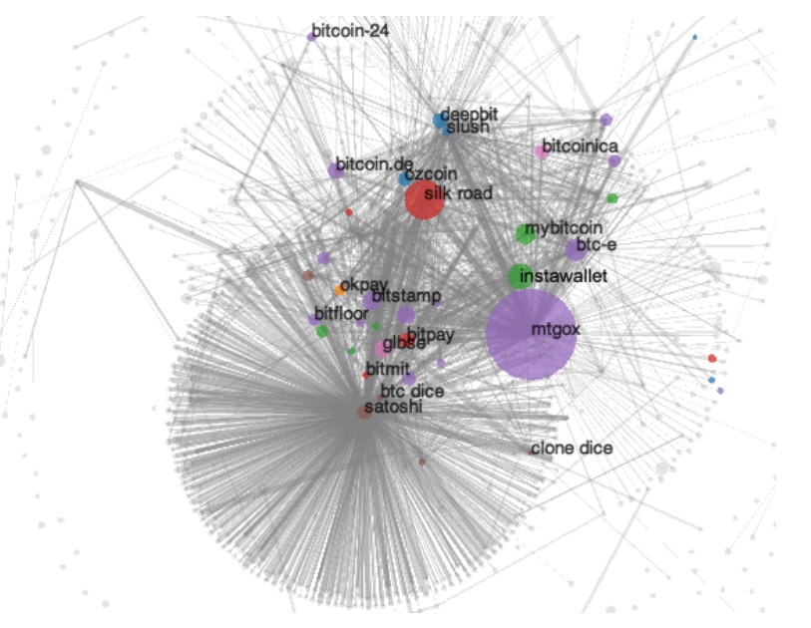
Linkage attack on Bitcoin network
A fistful of bitcoins: characterizing payments among men with no names, Meiklejohn et al. 2013

Slide 31
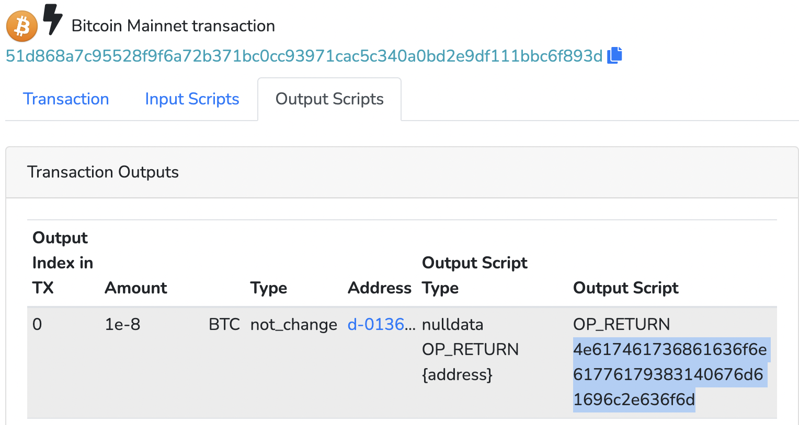
The Future of Burning Bitcoin
Christian Kane, Ian Matson, Clara Stadler
(course project TAMU CSCE465 Fall 2021)
11NeverGonnaG1veYouUpXXXXXXSv96UC
1NeverGonnaLetYouDownXXXXXXVxMjSH
1NeverGonnaRunAroundXXXXXXXVmw254
1AndDesertYouXXXXXXXXXXXXXXZGQ6kS
1NeverGonnaMakeYouCryXXXXXXcDMJ4h
1NeverGonnaSayGoodbyeXXXXXXZSwyeY
1NeverGonnaTe11ALieXXXXXXXXZ3GTDD
1AndDesertYouXXXXXXXXXXXXXXZGQ6kS
4e617461736861636f6e61776179383140676d61696c2e636f6d
=
Natashaconaway81@gmail.com
(We reached out to Natasha but she didn’t reply)

Slide 32
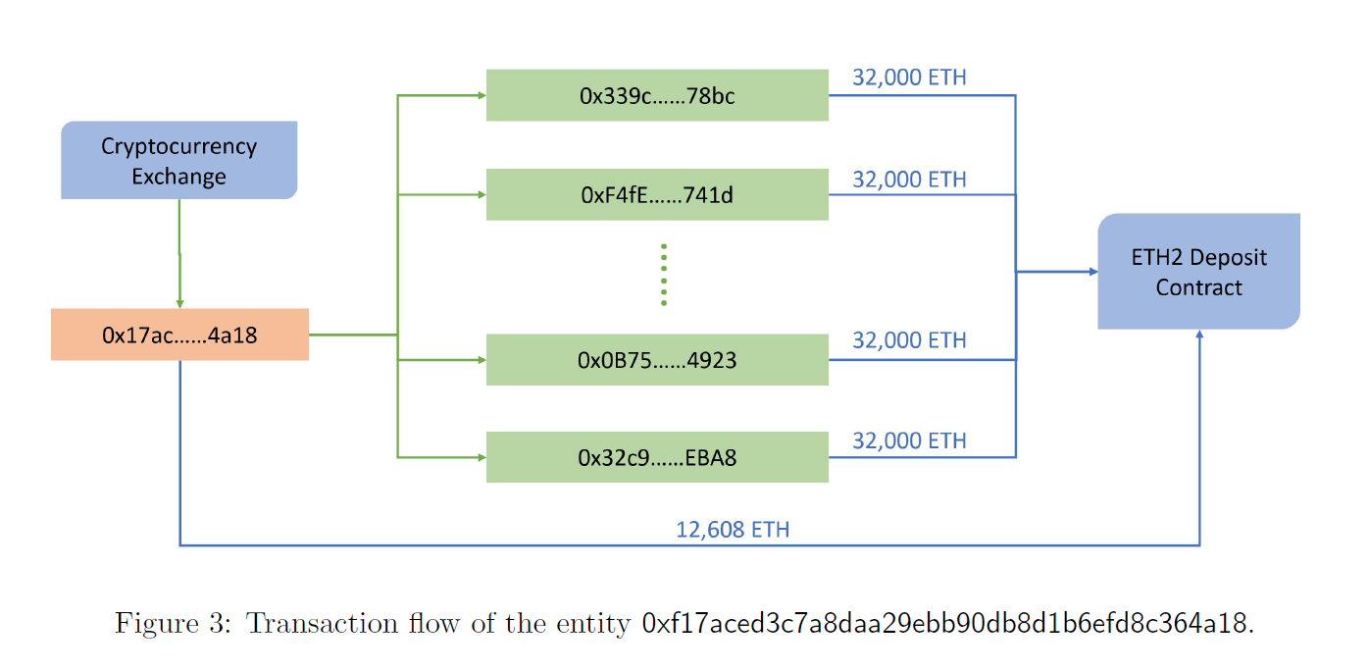
Ethereum Proof of Stake contract
- Yu Shen, Joseph Gibson, Sibo Min
(course project TAMU CSCE689 spring 2021)

Slide 33
Privacy problems in blockchain
All data are posted publicly on the chain
Pseudo-anonymity
Why do we post the data?
Notes:
Inherent

Slide 34
Privacy problems in blockchain
Can we prove data validity without revealing the data
Notes:
Inherent

Slide 35
Zero-knowledge proof (ZKP)
Public computation C
secret data
verifier
prover
C(data) = result +
Verification: ✓ or ✗
Correctness: honest prover, verification is ✓
Soundness (integrity): Pr [verification is ✓ and result ≠ C(data)] ≤ $\frac{1}{2100}$
Zero Knowledge (privacy): the proof leaks no information

Slide 36
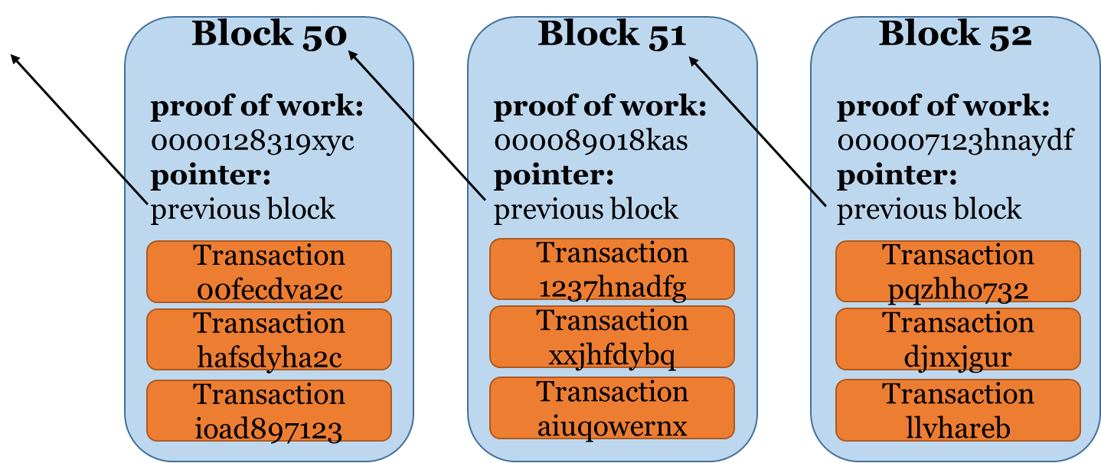
Solution: zero knowledge proof
Block 50
proof of work:
0000128319xyc
pointer:
previous block
Block 51
proof of work:
000089018kas
pointer:
previous block
Block 52
proof of work:
000007123hnaydf
pointer:
previous block
proof 1
proof 1
proof 1
proof 2
proof 2
proof 2
proof 3
proof 3
proof 3
Publish zero knowledge proofs of data validity on blockchain
Soundness: integrity/validity → consensus
Zero knowledge: privacy

Slide 37
Zerocash [BCG+14]
UTXO (unspent transaction output) in Bitcoin
Accounts in Ethereum
(bcxy2drugdygj, 1.3)
(bc1qxy2kgdygj, 3)
(uilanreprznp, 1.7)
3=1.3+1.7
Transfer 1.6 Bitcoins from to .
Signed by $sk_{A}$
$${pk}_{A}$$
$${pk}_{B}$$

Slide 38
Commitments and set membership
H( )
H( )
H( )
H( )
H( )
H( )
H(bc1qxy2kgdygj, 3)
Zero knowledge proof:
The coin/hash to spend is in the set
I know the pre-image of the commitment/hash
I can generate a valid signature
Witness/secret of ZKP: secret key, public key, amount

Slide 39
Proving membership: Merkle hash tree
root hash
Zero knowledge proof:
There is a Merkle tree path for the coin/hash
I know the pre-image of the commitment/hash
I can generate a valid signature
Witness/secret of ZKP: secret key, public key, amount, Merkle tree path
hash
hash
hash
hash
hash
hash
hash
H( )
H( )
H( )
H( )
H( )
H( )
H( )
H( )

Slide 40
Generating new coins
root hash’
root hash
H( )
H( )
H( )
H( )
H( )
H( )
H( )
H( )
H( )
H( )

Slide 41
Generating new coins
(bcxy2drugdygj, 1.3)
H( )
H( )
H( )
H( )
H( )
H( )
H( )
H( )
H( )
(uilanreprznp, 1.7)
Zero knowledge proof:
The coin/hash to spend is in the set
I know the pre-image of the commitment/hash
I can generate a valid signature
The amount of two new coins are less than the old coin
The hashes are computed from the new coins
Witness/secret of ZKP: secret key, public key, amount, new coins (receiver public key, amount)

Slide 42
Sending money
Encrypt under receiver’s public key
H( )
H( )
Enc( )
Enc( )
Zero knowledge proof:
The coin/hash to spend is in the set
I know the pre-image of the commitment/hash
I can generate a valid signature
The amount of two new coins are less than the old coin
The hashes are computed from the new coins
The encryptions are from the new coins

Slide 43
Privacy-preserving cryptocurrency
Block 50
proof of work:
0000128319xyc
pointer:
previous block
Block 51
proof of work:
000089018kas
pointer:
previous block
Block 52
proof of work:
000007123hnaydf
pointer:
previous block
proof 1
proof 1
proof 1
proof 2
proof 2
proof 2
proof 3
proof 3
proof 3
Publish zero knowledge proofs of data validity on blockchain

Slide 44
Agenda
What is ZKP?
History of ZKP
Why ZKP? Applications in blockchains and cryptocurrencies
Privacy-preserving cryptocurrency (Zcash)
How to build ZKP?
Construction of general-purpose zero-knowledge proofs from interactive proofs

Slide 46
Power of randomness, again!
Polynomial interpolation
f(x) = (x+3)(3x+5)(2x+7)
verifier
prover
g(x) = 6x³+49x²+128x+105
If f(x) - g(x) ≠ 0, but f(r) - g(r) = 0,
→ r is a root of f(x) - g(x),
→ Pr[r is a root] = $\frac{3}{|random space|}$
Verification: pick a random value r
test f(r) - g(r) = 0
Schwartz–Zippel lemma

Slide 47
Sumcheck problem
$$H=\sum_{b_{1},…,b_{k}∈\{0,1\}}{f(b_{1},…,b_{k})}$$
Multivariate polynomial $f(x_{1},…,x_{k})$
E.g., $f\left(x_{1},x_{2}\right)=1724+761253x_{1}+232x_{1}x_{2}+14x_{2}+2321x_{1}x_{2}^{3}$

Slide 48
Sumcheck problem
$$H=\sum_{b_{1},…,b_{k}∈\{0,1\}}{f(b_{1},…,b_{k})}$$
Multivariate polynomial $f(x_{1},…,x_{k})$
Number of evaluations in the sum: $2^{k}$
Time to compute each evaluation: $T$
Total time to compute the sum: $2^{k}⋅T$

Slide 49
Sumcheck protocol [LFKN92]
$$f(x_{1},…,x_{k})$$
verifier
prover
$$H=\sum_{b_{1},…,b_{k}∈\{0,1\}}{f(b_{1},…,b_{k})}$$
$$f_{1}(x_{1})=\sum_{b_{2},…,b_{k}∈\{0,1\}}{f(x_{1},b_{2}…,b_{k})}$$
Verify:
$$H= f_{1}\left(0\right)+f_{1}(1)$$
E.g., $f\left(x_{1},x_{2}\right)=1724+761253x_{1}+232x_{1}x_{2}+14x_{2}+2321x_{1}x_{2}^{3}$

Slide 50
Sumcheck protocol [LFKN92]
$$f(x_{1},…,x_{k})$$
verifier
prover
$$H=\sum_{b_{1},…,b_{k}∈\{0,1\}}{f(b_{1},…,b_{k})}$$
$$f_{1}(x_{1})=\sum_{b_{2},…,b_{k}∈\{0,1\}}{f(x_{1},b_{2}…,b_{k})}$$
Verify:
$$H= f_{1}\left(0\right)+f_{1}(1)$$
$f_{1}(r_{1})= f_{2}\left(0\right)+f_{2}(1)$
$$r_{1}$$
$$f_{2}(x_{2})=\sum_{b_{3},…,b_{k}∈\{0,1\}}{f(r_{1}, x_{2},b_{3}…,b_{k})}$$

Slide 51
Sumcheck protocol [LFKN92]
$$f(x_{1},…,x_{k})$$
verifier
prover
$$H=\sum_{b_{1},…,b_{k}∈\{0,1\}}{f(b_{1},…,b_{k})}$$
$$f_{1}(x_{1})=\sum_{b_{2},…,b_{k}∈\{0,1\}}{f(x_{1},b_{2}…,b_{k})}$$
Verify:
$$H= f_{1}\left(0\right)+f_{1}(1)$$
$f_{1}(r_{1})= f_{2}\left(0\right)+f_{2}(1)$
$f_{2}(r_{2})= f_{3}\left(0\right)+f_{3}(1)$
$$r_{1}$$
$$f_{2}(x_{2})=\sum_{b_{3},…,b_{k}∈\{0,1\}}{f(r_{1}, x_{2},b_{3}…,b_{k})}$$
$$r_{2}$$
$$f_{3}(x_{3})=\sum_{b_{4},…,b_{k}∈\{0,1\}}{f(r_{1}, r_{2},x_{3},b_{4}…,b_{k})}$$

Slide 52
Sumcheck protocol [LFKN92]
$$f(x_{1},…,x_{k})$$
verifier
$$H=\sum_{b_{1},…,b_{k}∈\{0,1\}}{f(b_{1},…,b_{k})}$$
prover
$$f_{1}(x_{1})=\sum_{b_{2},…,b_{k}∈\{0,1\}}{f(x_{1},b_{2}…,b_{k})}$$
$$r_{1}$$
$$f_{2}(x_{2})=\sum_{b_{3},…,b_{k}∈\{0,1\}}{f(r_{1}, x_{2},b_{3}…,b_{k})}$$
Verify:
$$H= f_{1}\left(0\right)+f_{1}(1)$$
$$f_{1}(r_{1})= f_{2}\left(0\right)+f_{2}(1)$$
……..
$$f_{i}(r_{i})= f_{i+1}\left(0\right)+f_{i+1}(1)$$
…….
$$r_{i}$$
$$f_{i+1}(x_{i+1})=\sum_{b_{i+2},…,b_{k}∈\{0,1\}}{f(r_{1}, …,r_{i},x_{i+1},b_{i+2}…,b_{k})}$$

Slide 53
Sumcheck protocol [LFKN92]
$$f(x_{1},…,x_{k})$$
verifier
$$H=\sum_{b_{1},…,b_{k}∈\{0,1\}}{f(b_{1},…,b_{k})}$$
prover
$$f_{1}(x_{1})=\sum_{b_{2},…,b_{k}∈\{0,1\}}{f(x_{1},b_{2}…,b_{k})}$$
$$r_{1}$$
Verify:
$$H= f_{1}\left(0\right)+f_{1}(1)$$
$$f_{1}(r_{1})= f_{2}\left(0\right)+f_{2}(1)$$
……..
$$f_{i}\left(r_{i}\right)= f_{i+1}\left(0\right)+f_{i+1}\left(1\right)$$
……..
$$f_{k−1}\left(r_{k−1}\right)= f_{k}\left(0\right)+f_{k}\left(1\right)$$
$$f_{k}\left(r_{k}\right)=f\left(r_{1},…r_{k}\right)$$
$$f_{2}(x_{2})=\sum_{b_{3},…,b_{k}∈\{0,1\}}{f(r_{1}, x_{2},b_{3}…,b_{k})}$$
…….
$$r_{i}$$
$$f_{i+1}(x_{i+1})=\sum_{b_{i+2},…,b_{k}∈\{0,1\}}{f(r_{1}, …,r_{i},x_{i+1},b_{i+2}…,b_{k})}$$
…….
$$r_{k−1}$$
$f_{k}(x_{k})=$ $f(r_{1}, …,r_{k−1},x_{k})$

Slide 54
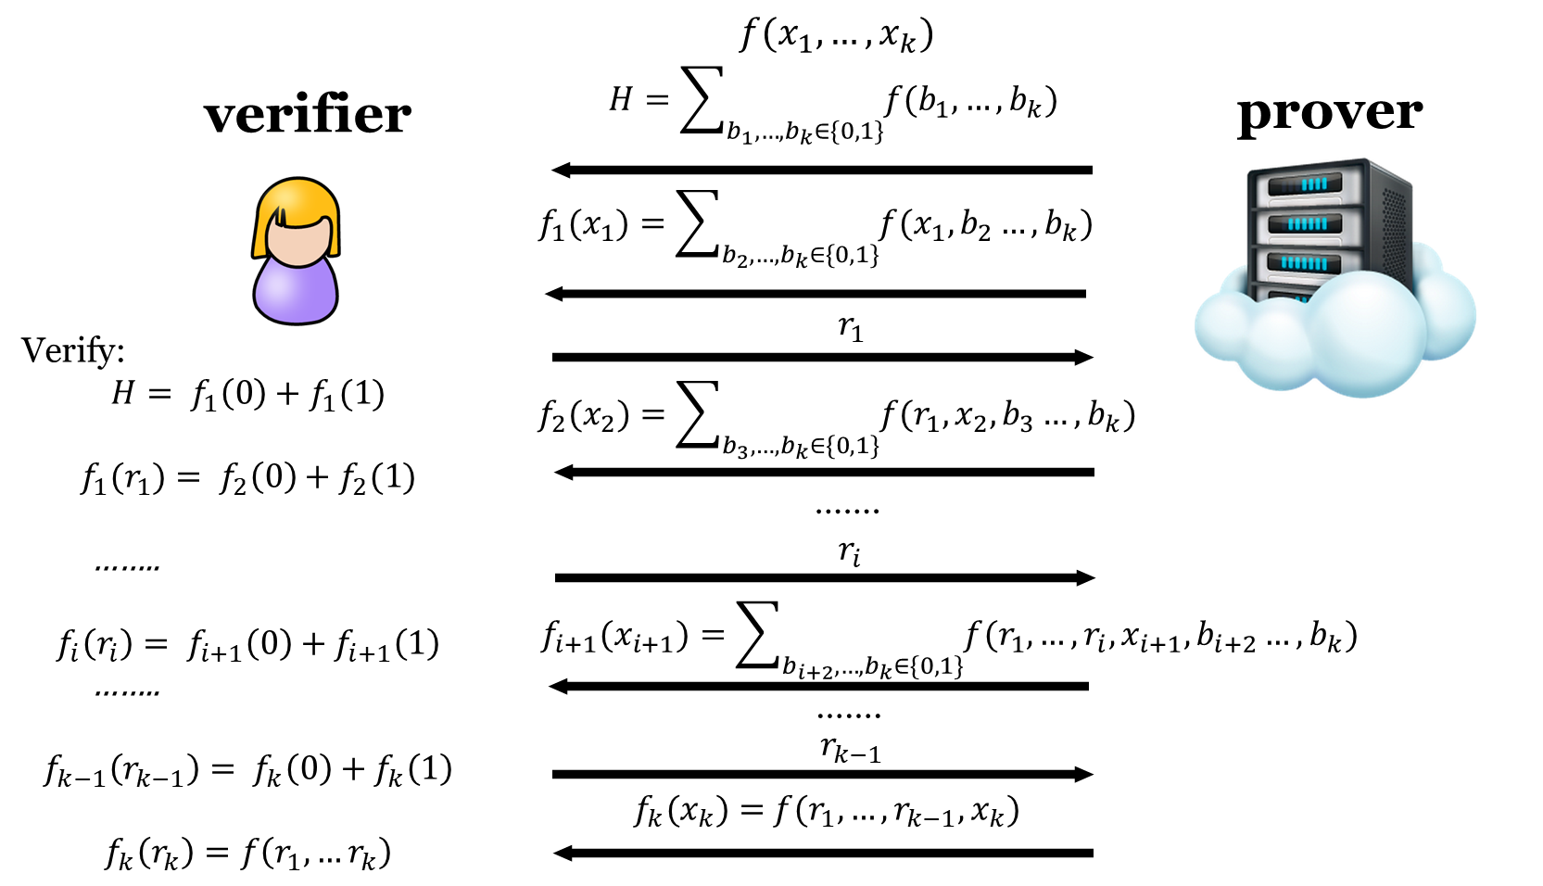
Correctness and soundness
Correctness: 1
Soundness: $\frac{dk}{|𝔽|}$

Slide 55
Complexity
Prover time: $O\left(2^{k}\right)$ if d=1
Proof size: $O\left(dk\right)$
Verification time: $O\left(dk\right)+T$
Total time to compute the sum: $2^{k}⋅T$
If k = log n and d is constant:
linear prover, logarithmic proof and verifier

Slide 56
GKR protocol [GKR08]
output
Output (result)
layer 0
$$V_{0}(⋅)$$
$$V_{0}(\vec{r_{0}})$$
sumcheck
×
……
×
prover
layer 1
$$V_{1}(⋅)$$
verifier
$$V_{1}(\vec{r_{1}})$$
+
×
……
×
sumcheck
$$V_{2}(⋅)$$
$$V_{2}(\vec{r_{2}})$$
……
layer D-2
……
$$V_{D−2}(⋅)$$
…
sumcheck
×
×
……
+
layer D-1
$$V_{D}(\vec{r_{D}})$$
$$V_{D−1}(⋅)$$
×
+
……
+
layer D
$$V_{D}(⋅)$$
Input (data)
$V_{D}(0,0,0)$=a0
$V_{D}(0,0,1)$=a1
$V_{D}(0,1,0)$=a2
…
$$V_{D}(\vec{r_{D}})$$
$V_{i}(x)=∑f(V_{i+1}(x)$)

Slide 57
Properties of the GKR protocol
Correctness: 1
Soundness: O($\frac{D\log{C}}{|𝔽|}$)
Proof size: $O(D\log{C})$
Verifier time:
Worst case: O(C)
Structured circuits: $O(D\log{C}$)
e.g., matrix multiplication, data parallel circuits

Slide 58
Achieving optimal prover time
O(C³) [GKR08]
O(C log C) [CMT12]
O(C) for arbitrary layered circuits [XZZ+19]
0.41µs/gate
O(C) for arbitrary circuits [ZLW+21]
0.48µs/gate
Libra: Succinct Zero-Knowledge Proofs with Optimal Prover Computation. T. Xie, J. Zhang, Yupeng Zhang, C. Papamanthou and D. Song, Crypto 2019.
Doubly Efficient Interactive Proofs for General Arithmetic Circuits with Linear Prover Time. J. Zhang, T. Liu, W. Wang, Y. Zhang, D. Song, X. Xiang and Yupeng Zhang, CCS 2021

Slide 59
Summary
Definitions of zero-knowledge proof
History and recent development of zero-knowledge proof
Privacy-preserving cryptocurrencies
General-purpose interactive proofs (GKR protocol)
Thank you!
Q&A
Yupeng Zhang
zhangyp@tamu.edu

